Slide 1
HTML5 & CSS3
NGUYỄN THÀNH LUÂN

Slide 2
Overview
What is HTML ?
HTML Structure
Main elements in HTML
What new elements in HTML5
CSS3
How to layout web page using CSS

Slide 3
WHAT IS HTML ?
HTML stands for Hyper Text Markup Language
Use to make static webpage
Use tag to mark element on the document

Slide 4
HTML structure
<!DOCTYPE html>
<html lang="en">
<head>
</head>
<body>
</body>
</html>

Slide 5
SYNTAX OF HTML TAG (ELEMENT)
<tagname attribute=“”>
<chilelement>Content is here</chilelement>
` </tagname>
<tagname attribute=“”/>
The attribute description for tag element.
Every tag have 3 attributes is class and id style
You can place custom attribute into tag, but it will not affect by browser, it just use for JavaScript accessing

Slide 6
Main elements in HTML
<span>
<div>
<img> <img src=“” alt=“”/>
<a> <a href=“” title=“”/>
<h1> … <h6> heading
<hr>
<strong>
<pre>
<del>
<mark>
<i>
<ul> - <li>
<ol> - <li>

Slide 7
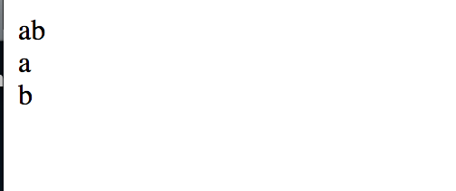
The difference between <span> and <div>
For example
<span>a</span><span>b</span>
<div>a</div><div>b</div>

Slide 8
Important Elements in HTML
<form></form>
<input>
<select>

Slide 9
Form
Form allows clients to submit or send data to the server. For example Login form, SignUp Form
Form attribute: action, method, enctype
Action: “process data link”
Method: GET|POST
Enctype: application/x-www-form-urlencoded | multipart/form-data | text/plain
In Form, have children elements defined for input view. For example
<input type=“” name=“” value=“” placeholder=“”/>
type attribute = text|number|phone|mail|button|checkbox|image|date|color|month|password|url|week|file|radio|check
<select name=“”>
<option value=“”>label name</option>
</select>
<label></label>

Slide 10
Demo FORM
Teacher demo about form

Slide 11
Some New Elements in HTML5
Section
Header
Nav
Footer
Article
Video
Audio

Slide 12

CSS
If HTML is the backbone of a webpage, CSS is exactly is the skin of it
CSS stands for Cascading style sheets
Is a collection of styles used to change the appearance of
HTML elements on Webpages
Defined a set of standard rules that provide better control over
The page layout and appearance.

Slide 13
HOW TO PUT CSS INTO HTML DOCUMENTATION
We have three ways to put CSS into HTML
External
<link rel="stylesheet" type="text/css" href="styles.css”>
Internal
<style type="text/css">
/*Noi dung CSS*/
</style>
Inline Style, embed Style

Slide 14
CSS
Each CSS rule consists of the following parts:
Selector : Declaration block
For example
h1 {
color:blue;
font-size:12px
}

Slide 15
CSS Selector
CSS selectors are used to “find” HTML elements base on their name, id, class, attribute, and more.
CSS provide three main selector :
+, element selector
+, id selector
+, class selector
+, Combinator Selector
+, Pseudo Selector
+, Atribute Selector

Slide 16
COMBINATOR SELECTOR
Descendant Selector (Chọn con cháu)
div p{ background-color: yellow; }
<div>
<p>a</p>
<p>b</p>
<span>
<p></p>
</span>
</div>

Slide 17
COMBINATOR SELECTOR
Child Selector
div > p { background-color: yellow; }
<div>
<p>a</p>
<p>b</p>
<span><p></p></span>
</div>

Slide 18
COMBINATOR SELECTOR
Adjacent Sibling
div+ p {
background-color: yellow;
}
<div>
<p>a</p>
</div>
<p>b</p>

Slide 19
General Sibling Selector
Select all elements that are siblings of a specified element
div ~p{
background-color: yellow;
}
<div>a</div>
<p>b</p>
<p>c</p>

Slide 20
PSEUDO SELECTOR
:checked
:visited
:link
:before
:after
:hover
:first-line
:nth-child(i)
:nth-last-child(i)
:nth-of-type(i)
:nth-last-of-type(i)
:first-child
:last-child

Slide 21
CSS SPECIFICITY
Many rules apply to an element. The chosen rule will have higher specificity.
Specificity Hierarchy :Every element selector has a position in the Hierarchy.
Inline style: Inline style has highest priority.
Identifiers(ID): ID have the second highest priority.
Classes, pseudo-classes and attributes: Classes, pseudo-classes and attributes are come next.
Elements and pseudo-elements: Elements and pseudo-elements have lowest priority.
Rules have same specificity then choose the last rule
How to calculation the specificity
Element selector : 1 point
Pseudo, attribute,class: 10 point
Id : 100 point
Universal: 0 point (*)

Slide 22
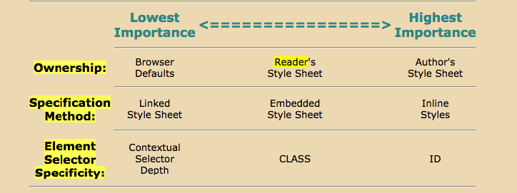
What is the meaning of CASCADING

Slide 23
HOW TO LAYOUT PAGE USE CSS
Before we skip through this slide, let review few some must-know CSS’ properties.

Slide 24
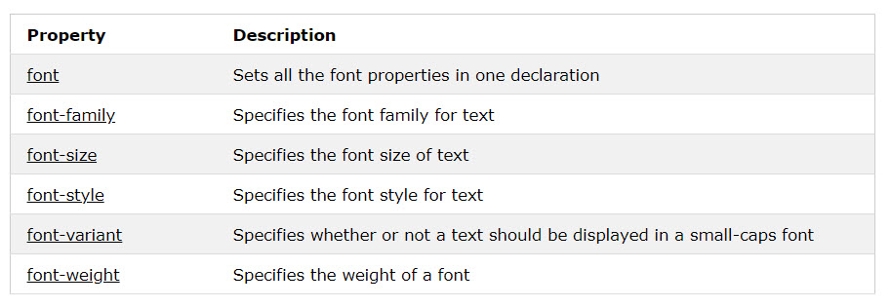
CSS FONT

Slide 25
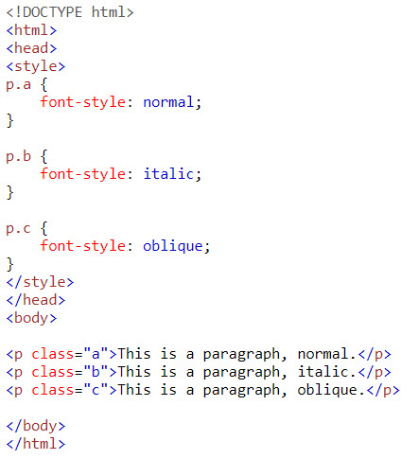
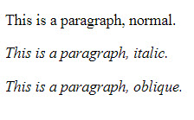
CSS FONT

Slide 26
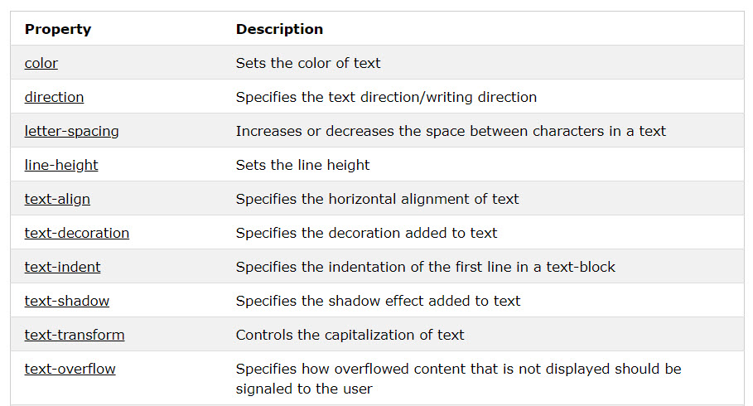
CSS TEXT

Slide 27
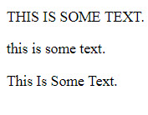
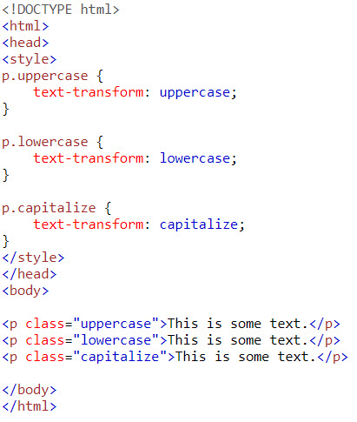
CSS TEXT

Slide 28
CSS BACKGROUND
Property | Description
background | Sets all the background properties in one declaration
background-color | Sets the background color of an element
background-image | Sets the background image for an element url(‘..images/pictures.png’)
background-origin | Specifies where the background image(s) is/are positioned
background-position | Sets the starting position of a background image
background-repeat | Sets how a background image will be repeated
background-size | Specifies the size of the background image(s)

Slide 29
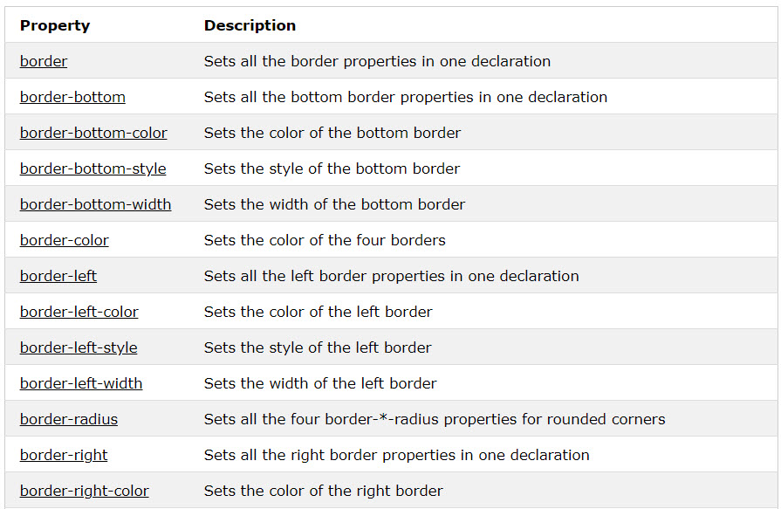
CSS BORDER

Slide 30
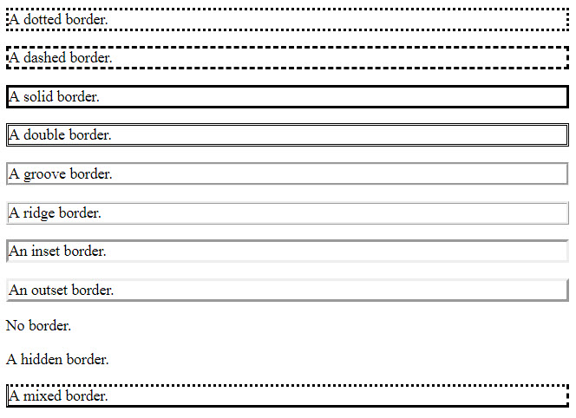
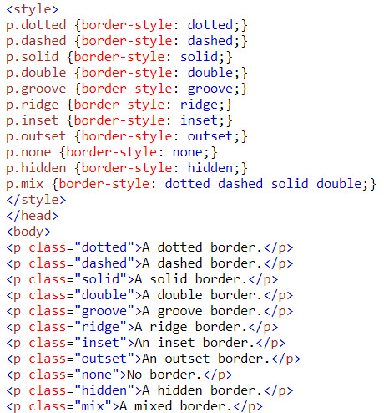
CSS BORDER

Slide 31
BOX MODEL
All HTML elements can be considered as boxes. In CSS, the term "box model" is used when talking about design and layout.
The CSS box model is essentially a box that wraps around every HTML element. It consists of: margins, borders, padding, and the actual content

Slide 32
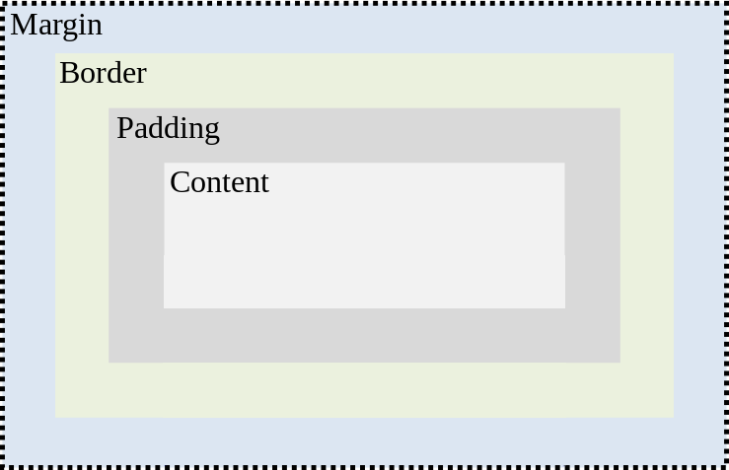
BOX MODEL

Slide 33
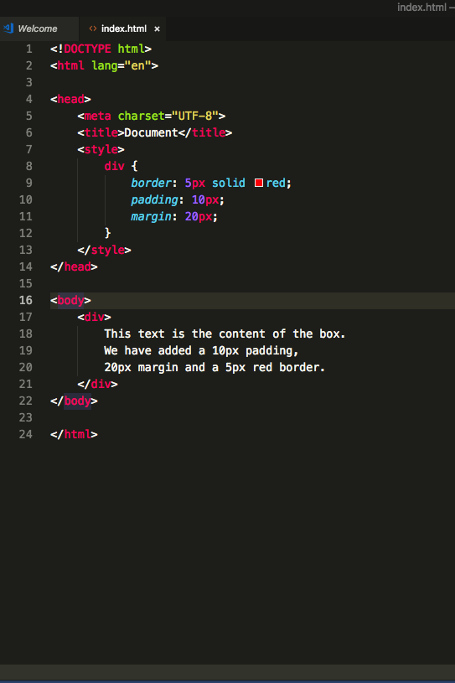
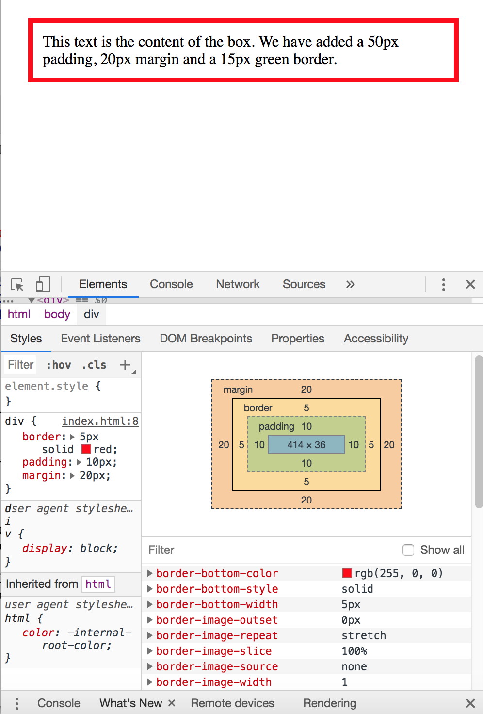
BOX MODEL

Slide 34
How to layout webpage
To layout an webpage, you must remember two things:
How to positioning HTML elements (position,float,clear properties)
The display type of elements ( display properties)

Slide 35
POSITIONING HTML ELEMENTS
CSS positioning properties:
Are used to control the placement of elements on a Web page.
The position property is used to position an element on a Web page using the following positioning methods:
Static
Fixed
Relative
Absolute
Sticky
Position property comes with another bunch properties is margin, left, top, right, bottom properties

Slide 36
STATIC POSITION
HTML elements are positioned static by default
An element with position: static; is not positioned in any special way; it is always positioned according to the normal flow of the page
Static Position do not support left, right, bottom, top properties

Slide 37
RELATIVE POSITION
An element with position: relative; is positioned relative to its normal position.
Setting the top, right, bottom, and left properties of a relatively-positioned element will cause it to be adjusted away from its normal position. Other content will not be adjusted to fit into any gap left by the element.

Slide 38
FIXED POSITION
An element with position: fixed; is positioned relative to the viewport, which means it always stays in the same place even if the page is scrolled. The top, right, bottom, and left properties are used to position the element.

Slide 39
ABSOLUTE POSITION
An element with position: absolute; is positioned relative to the nearest positioned ancestor (instead of positioned relative to the viewport, like fixed).

Slide 40


STATIC POSITION
#two {
background: green;
margin-left:20px
}

Slide 41
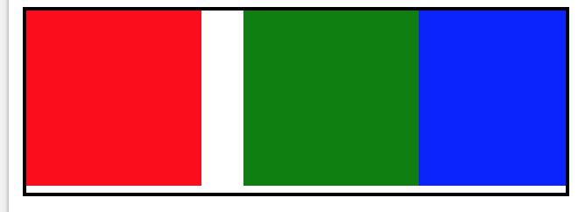
RELATIVE POSITION
#two {
position:relative;
background:green;
left:20px
}

Slide 42
NOTE
In Absolute position, if the parents element don’t have relative properties, the child element which has absolute properties will get viewport as parents

Slide 43
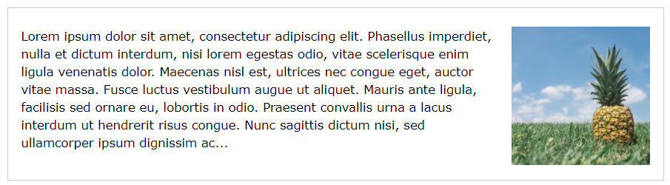

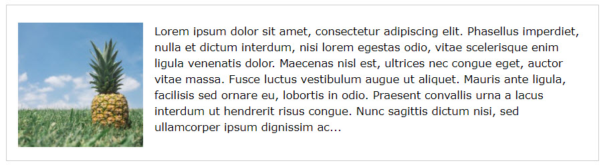

POSITIONING HTML ELEMENT

Slide 44
DISPLAY PROPERTIES
This properties control what the way of elements display
The popular properties is: inline, block, inline-block

Slide 45
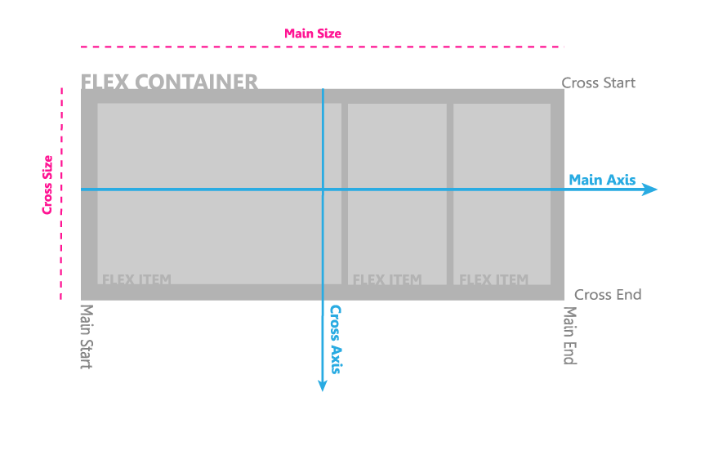
FLEXBOX

Slide 46
FLEXBOX
display: flex
flex-direction: row | row-reverse | column | column-reverse;

Slide 47
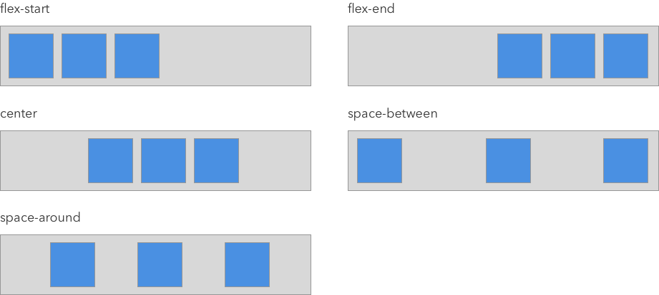
JUSTIFY-CONTENT
Justify-content
This defines the alignment along the main axis

Slide 48
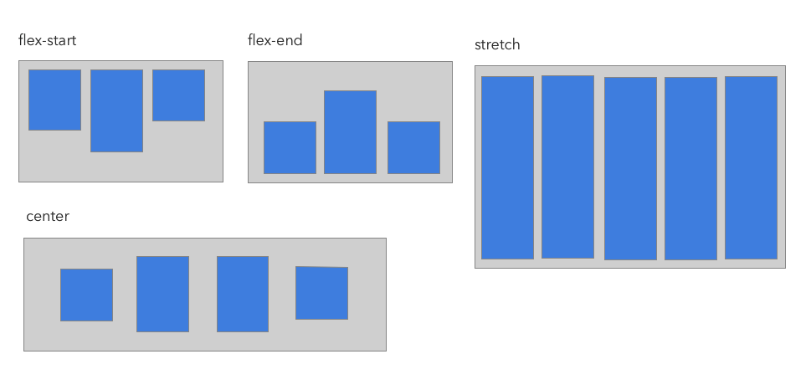
FLEXBOX
Align-items
This defines the alignment along the cross axis

Slide 49
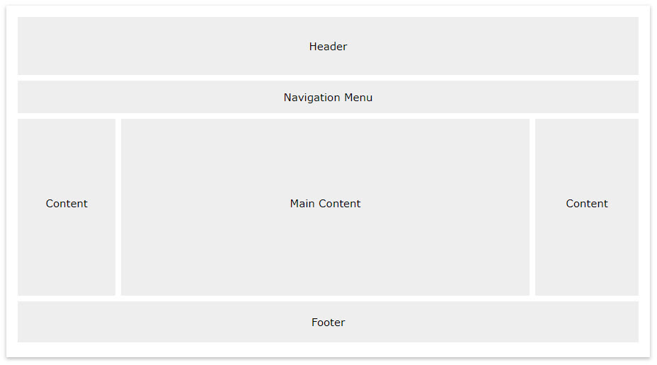
LAYOUT

Slide 50

SUMMARY
Advanced properties of CSS
Properties of CSS3
Designing layout of website

